Slide 1
INDIVIDUAL HOMEWORK Logic circuits
Bercea Mihai Andrei
Group 911

Slide 2
Problem statement
Draw a logic circuit having 3 input wires and containing all basic and derived gates. Write the corresponding Boolean function, simplify it and then draw a simplified circuit equivalent to the initial one.

Slide 3
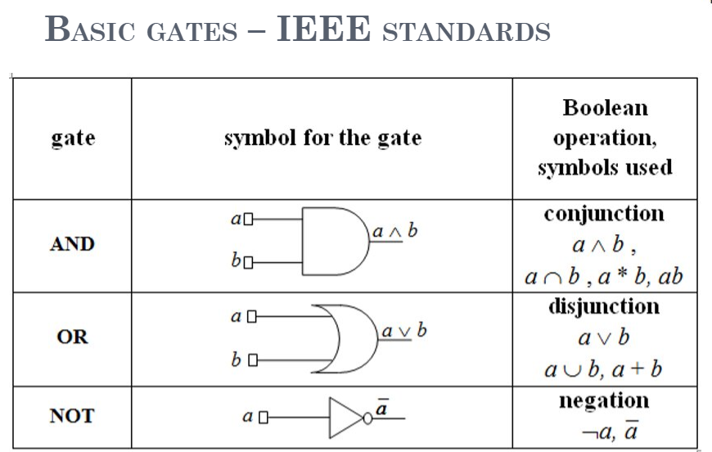
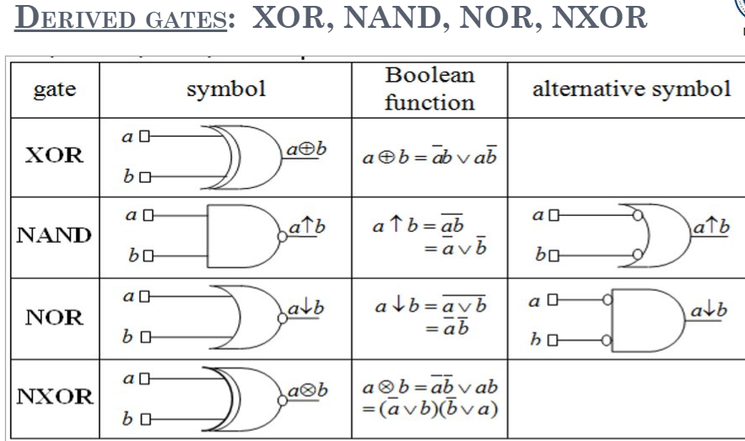

Theoretical Results

Slide 4
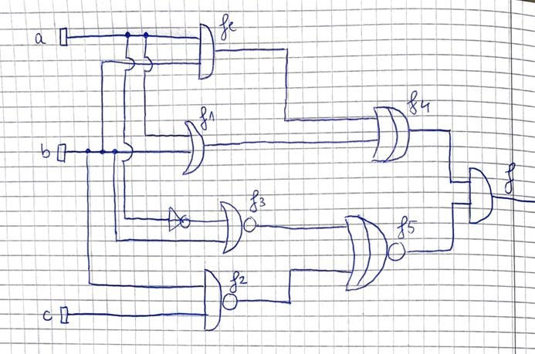
Initial logic circuit

Slide 5
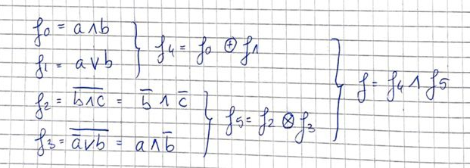
The functions of the initial logic circuit

Slide 6
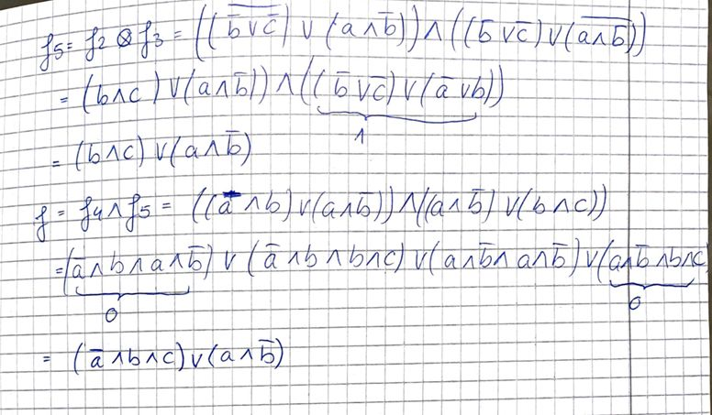
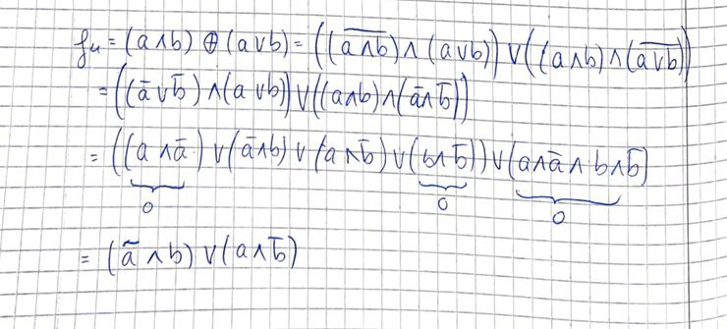
Simplification of the boolean functions

Slide 7
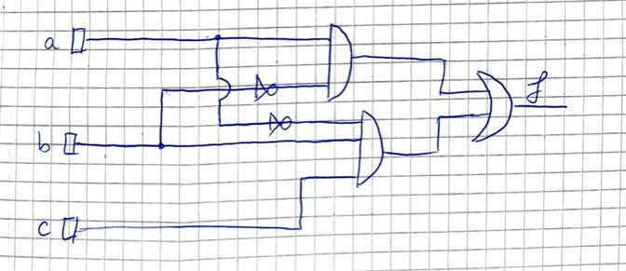
The simplified circuit

